Slide 1
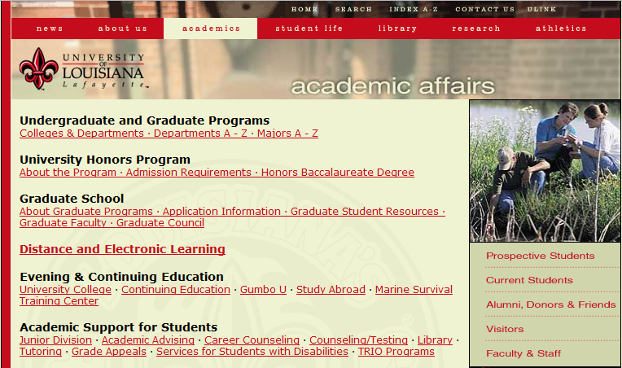
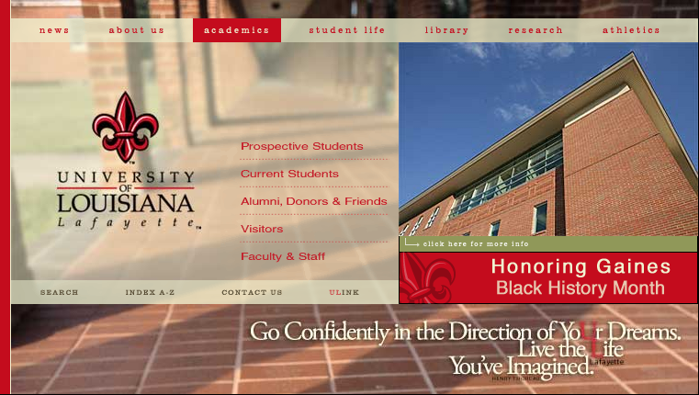
a subtle but visible change in top navigation bar styling, indicating we have left the home page and entered the site
Notes:
VISIBILITY: NAVBAR

Slide 2
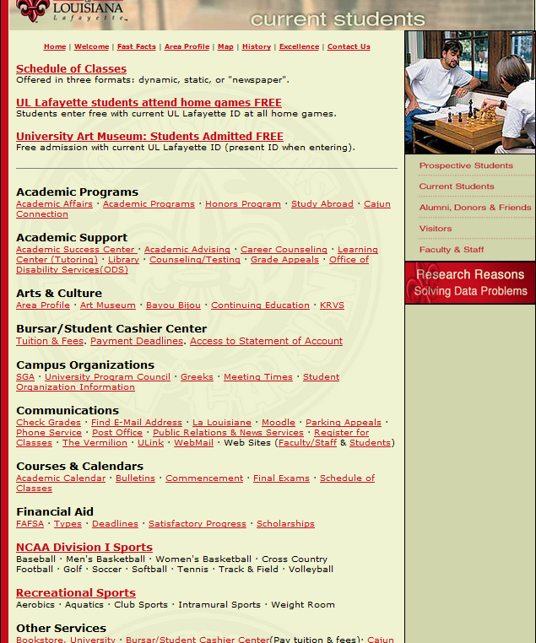
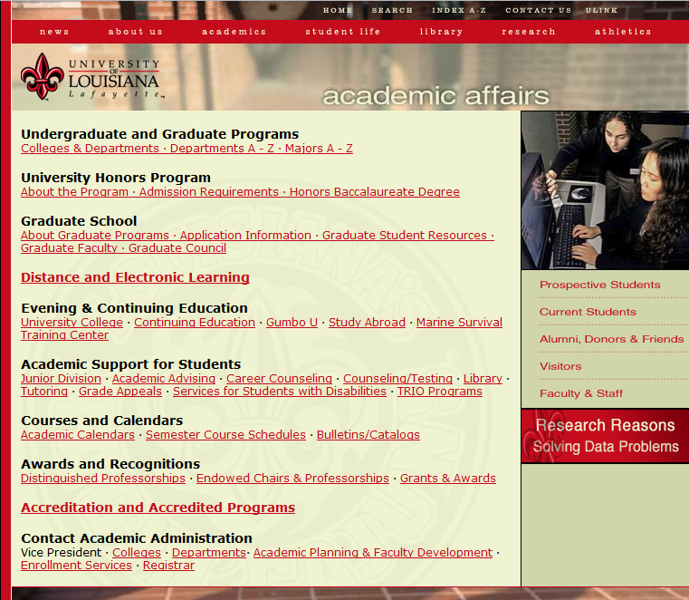
Notes:
2. MATCH TO REAL WORLD
making information appear in a natural and logical order
CURRENT STUDENTS: Links organized alphabetically
ACAD AFFAIRS: organization is not intuitive at all. Expect to see contact and courses higher on the page.

Slide 3
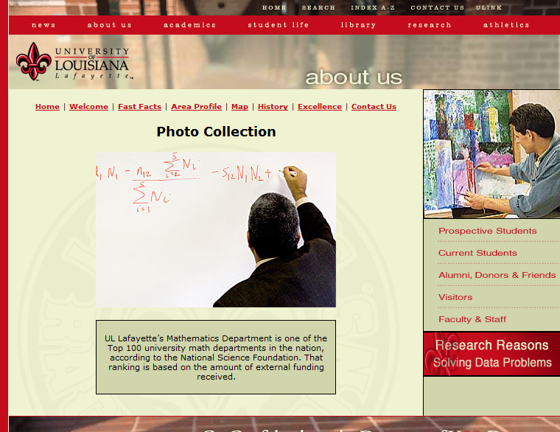
Notes:
3. USER CONTROL AND FREEDOM
“collection” but user has no control over which photo is displayed.

Slide 4
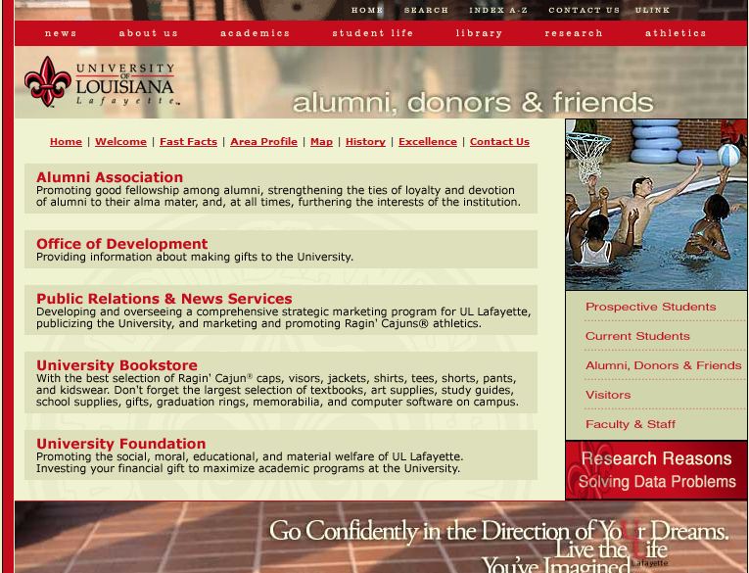

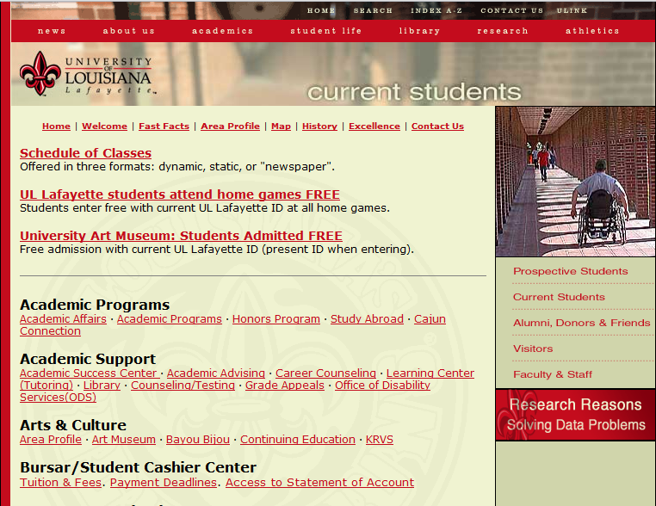

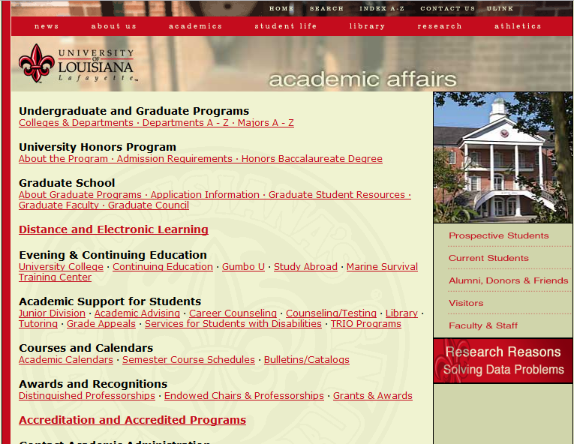
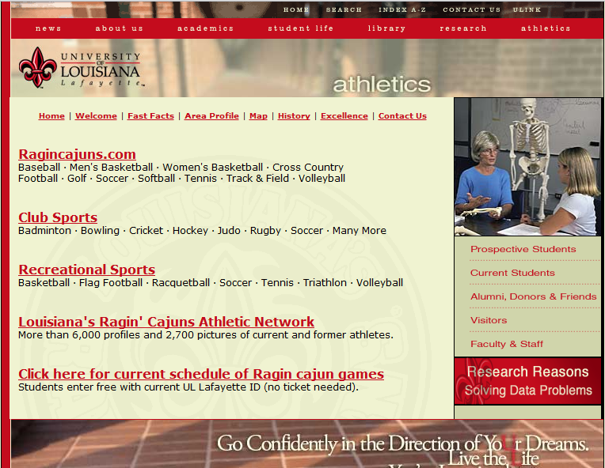
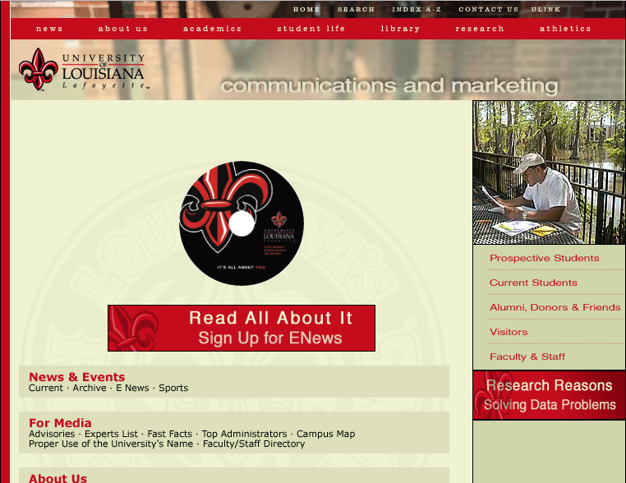




Notes:
4. inCONSISTENCY: links
ACAD/GRAD: appears to be individual links below “graduate school” as well
ALUMNI/SCHED: similar format but different styles
ATH/NEWS: also similar format w/ diff styles. a mix between acad/grad and alumni/sched.

Slide 5
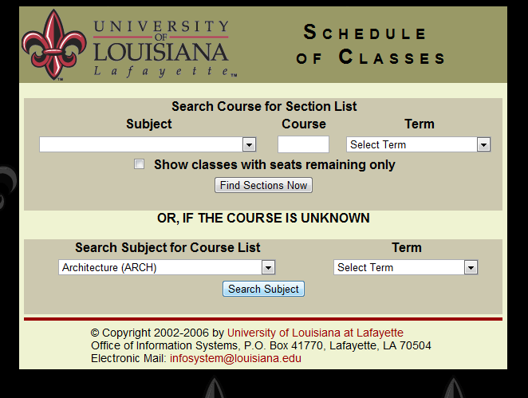
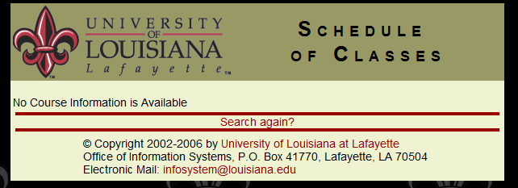
Notes:
5. ERROR PREVENTION
No form validation.

Slide 6
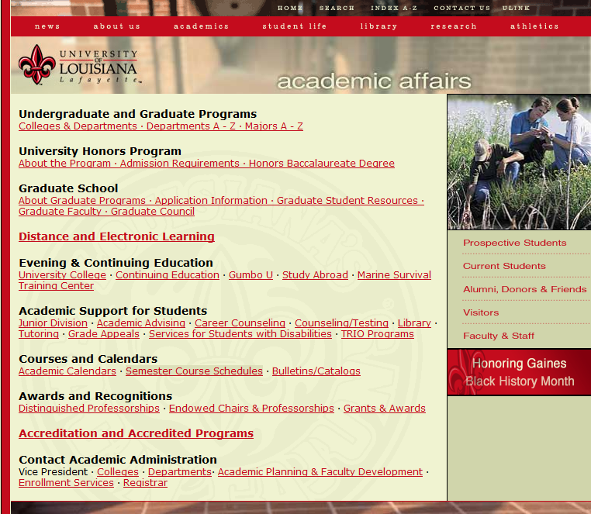
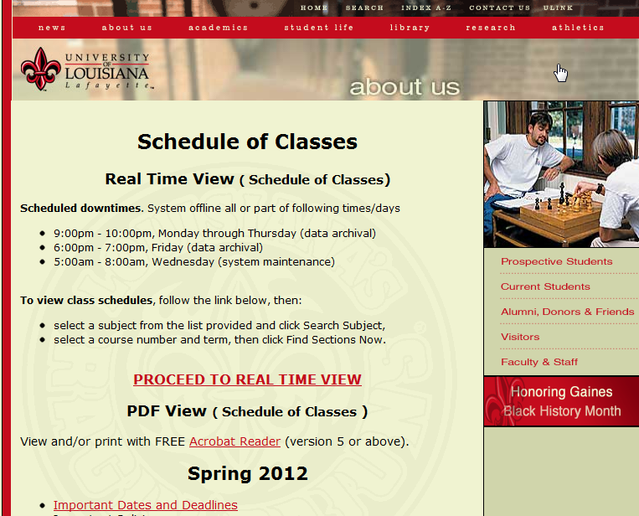
selecting a link from “academic affairs” somehow brings us to “about us”
Notes:
6. RECOGNITION:
-title header displays the overall topic for the content, but seems somewhat unpredictable and thus unreliable.
-certainly less effective than breadcrumbs, and reveals underlying lack of coherence in the information architecture
-if we happen to rollover the title header and notice the mouse cursor (not likely), we discover that the title header is clickable. no idea where it goes.

Slide 7
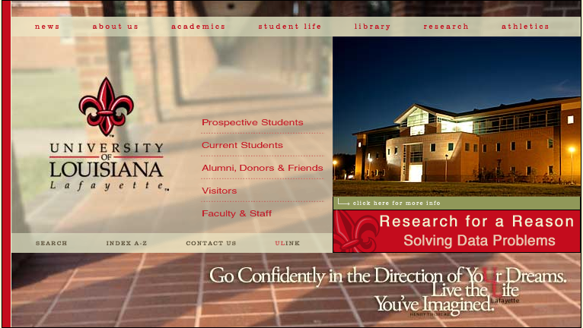

Notes:
7. FLEXIBILITY AND EFFICIENCY: ULINK
Direct link to ULink portal for registered students

Slide 8
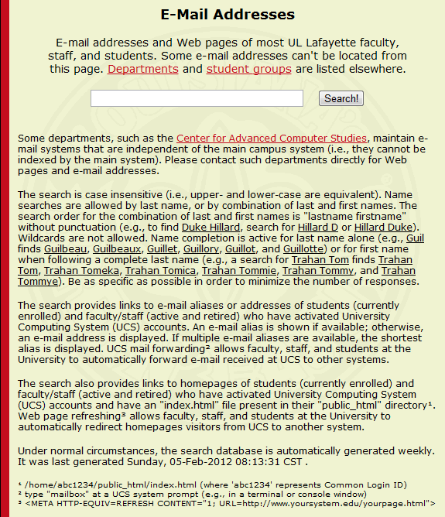
Notes:
8. AESTHETICS
Big blocks of unnecessary text discourage us from using this tool.
Could eliminate all this text with validation or different forms of input “LAST NAME: _________”

Slide 9
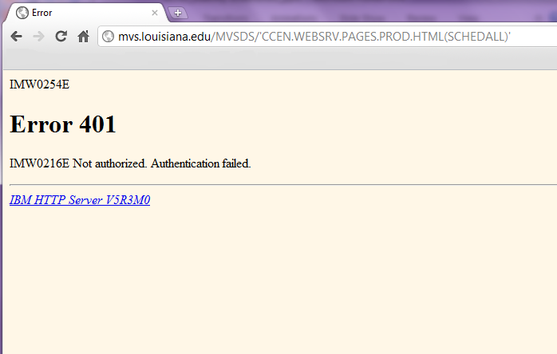
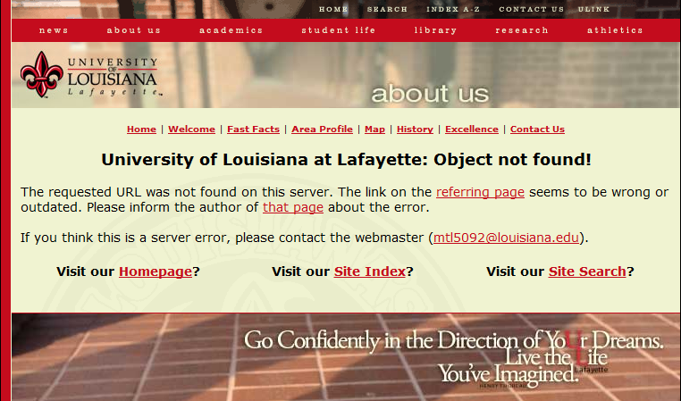
Notes:
9. ERROR RECOVERY
Two different error messages
Top: schedule of classes-->list of courses-->logon-->cancel
(server error)
Bottom: home-->academics-->undergrad and grad programs-->arts-->contactus
(bad pathway)

Slide 10
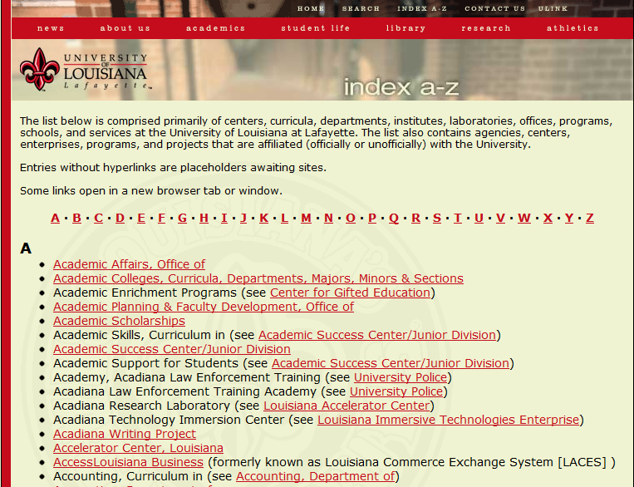
Notes:
10. HELP: index
Index is an alphabetized list of organizations associated with the university, rather than an index of the site

